Slide 1
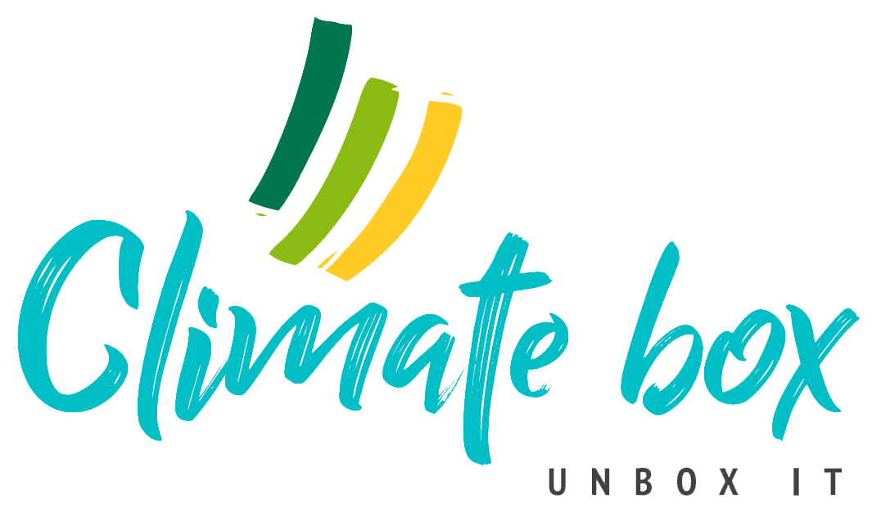
Topic 4 – Personal Choice: Consumption and efficiency
Unit 2 – Consumer choices
Activity 2 - The effects of the Domino Effect & Publicity on collective consumption practices

Slide 2
Do you believe in the positive Domino Effect on a person’s consumption habits?
Domino effect: starting small can lead to further, more meaningful actions.
Buying LED light bulbs might lead to:
-> wearing warmer clothing and turning down the thermostat
-> changing curtains to decrease heat loss
-> insulating doors/windows
-> buying energy-efficient appliances
-> installing a programmable thermostat
Notes:
Self-Assessment of the unit. Please copy this slide for all units you want to include in the module.

Slide 3
Do you believe there is a ‘counter-Domino‘ effect?
The ‘counter-Domino‘ effect: if a product is advertised as sustainable, people will simply consume more of it and negate its ecological advanages.
Examples:
Recycling -> using more paper
A more efficient fuel -> driving more
More efficient heating/cooling systems -> putting the temperature higher / lower

Slide 4
If you are engaged in a public action to save the climate, will you do more or less in private?
Some people would say that when they have signed a petition on climate change, they have already done their part.
So does public engagement with climate make people more active in their day-to-day climate-friendly behavior, or less?
Do believe that people who are very public about their actions, such as climate activists, really commit to it in their personal actions?
Notes:
Self-Assessment of the unit. Please copy this slide for all units you want to include in the module.

Slide 5
Is it not better to do what you can quietly?
Do you think private engagement with climate issues – doing you part away from the public’s judgmental eyes – would make you more prone to continue your eco-friendly consumption behavior?
Is this a way that reflects more closely your true values?
Or is it the opposite – is lone climate action doomed to impotence? After all, a single person can achieve so little.

