Slide 1
Topic 4 – Personal Choice: Consumption and efficiency
Unit 1 - Energy Efficiency
Activity 3 – Heating Efficency

Slide 2
QUESTION 1
Do you use any methods to control the amount of sunlight reaching inside your home?

Slide 3
Let the sun shine according to your wishes
Use external blinds. In this way you will reduce heating costs by both using the lower winter sun for some extra heating, and spend less on cooling your home by limiting the sun during the summer. Another way to achieve such an effect is to plant a deciduous tree on the south side of the building. It will provide shade and relief from the heat during the summer. In the winter, due to the lack of leaves, the sun will pass almost unimpeded through the tree and into the building.
Notes:
Self-Assessment of the unit. Please copy this slide for all units you want to include in the module.

Slide 4
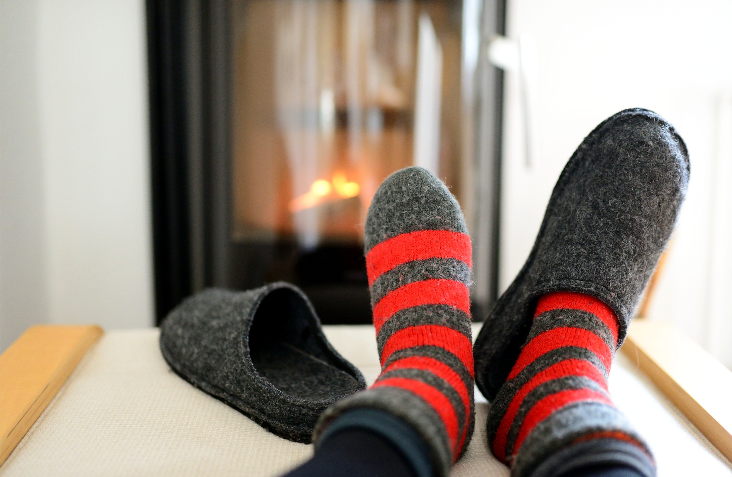
QUESTION 2
Do you track your home building temperature?

Slide 5
No warmer/ colder than necessary
In many homes it is often warmer than necessary. Check this for yourself without the help of a thermometer. At what temperature do you feel comfortable? Usually, this temperature is lower than the one set by us. Reducing the room temperature by only one degree Celsius can save up to 6% on heating costs!
Notes:
Self-Assessment of the unit. Please copy this slide for all units you want to include in the module.

Slide 6
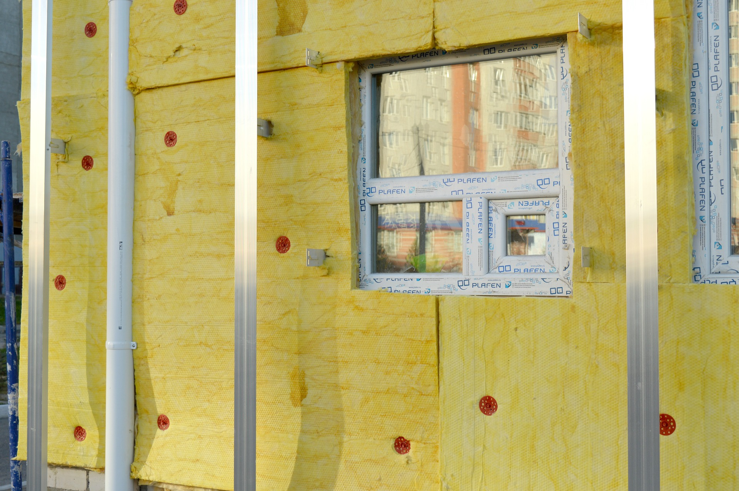
QUESTION 3
Do you use thermal isolation in your home?

Slide 7
Proper construction and home renovation
If you are planning to renovate your home, consider adding thermal insulation. In this case, additional costs are usually lower than expected, but you will benefit significantly from this since the insulation of the building has the greatest impact on heating energy consumption. In addition to the significant reduction to heating costs, the level of indoor comfort in the lower temperatures during the winter season will increase thanks to the warmer surfaces of insulated building elements.
Notes:
Self-Assessment of the unit. Please copy this slide for all units you want to include in the module.

Slide 8
Good insulation comes from above
It is usually relatively easy to isolate ceilings on the top floor, even in buildings with facades in bad condition. The investments pay off quickly as most heat is proven to be lost through the roof.
Notes:
Self-Assessment of the unit. Please copy this slide for all units you want to include in the module.

Slide 9
Be careful with ‘thermal bridges’
Good thermal insulation should not have any voids or areas filled with non-thermal insulation material, as are the so-called “thermal bridges”. They will increase energy consumption. To provide effective insulation, it must be installed from the outside of the walls of your building.
Notes:
Self-Assessment of the unit. Please copy this slide for all units you want to include in the module.

Slide 10
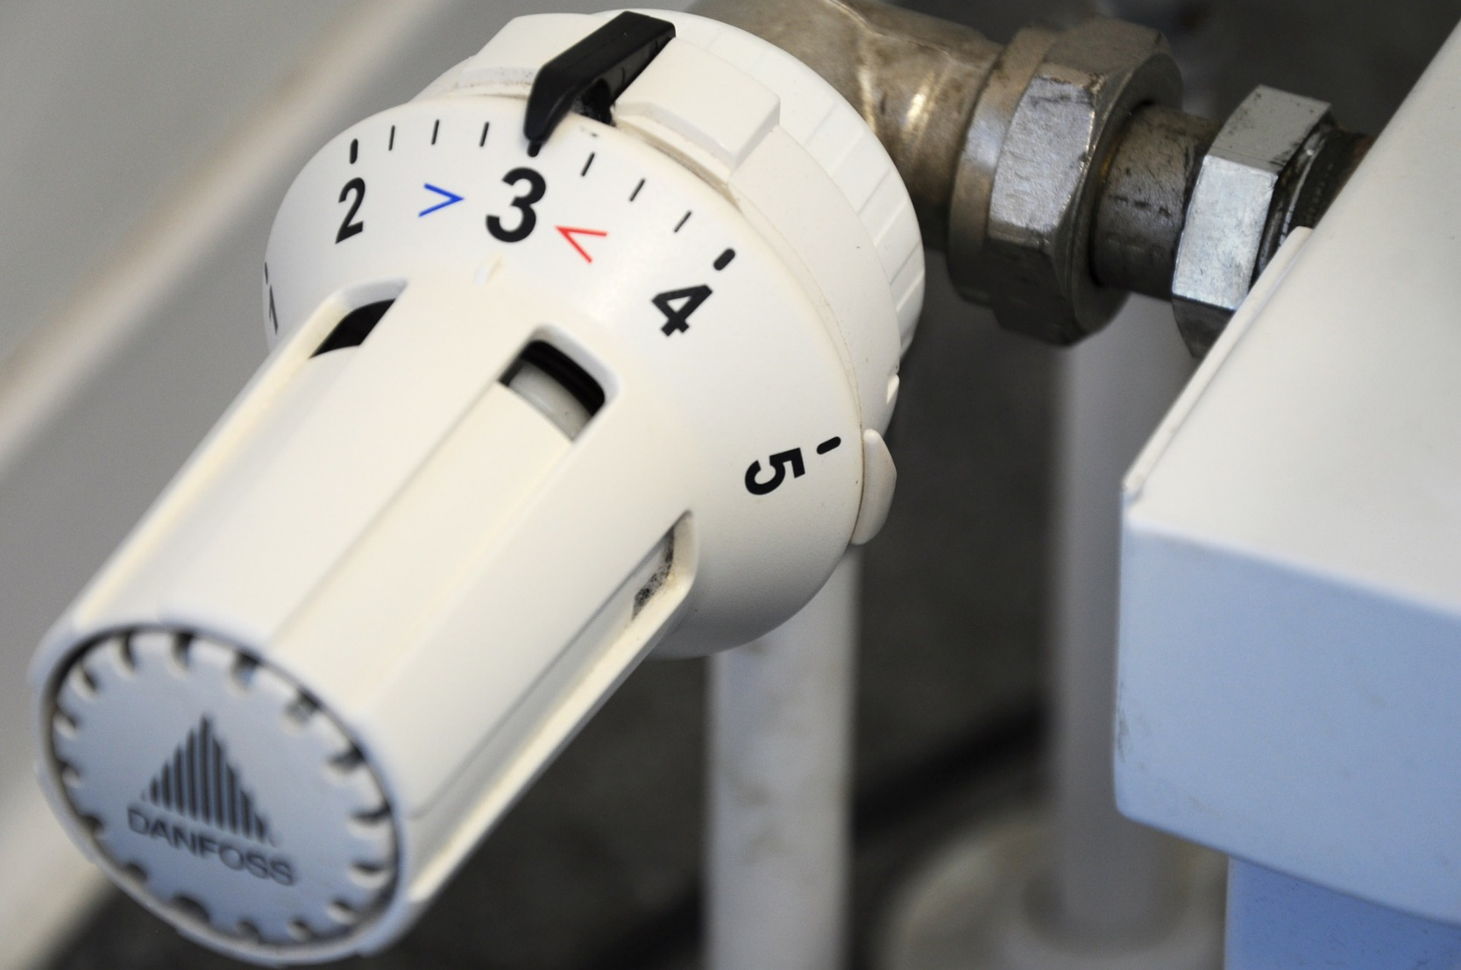
QUESTION 4
Do you use a thermostat?
If so, do you take care where you place it?

Slide 11
Take care where you place your thermostat
Modern central heating systems require a modern control system. It leads to reduction of energy consumption, especially when a timer is used. Make sure that the thermostat is not exposed directly to sunlight or that it is not affected by other sources of heat, such as electrical appliances.
Furthermore, thermostatic radiator valves allow for the setting of different temperatures for the radiators in your home so that you can adjust the temperature in individual premises. This reduces energy consumption and improves comfort. To ensure the longer life of appliances, do not close the valves in the summer.
In single-family homes, the thermostatic radiator valve does not need to be installed in a room where there is a room thermostat to control the heating system. If that is still the case, the valve must always be fully open.
Notes:
Self-Assessment of the unit. Please copy this slide for all units you want to include in the module.

Slide 12
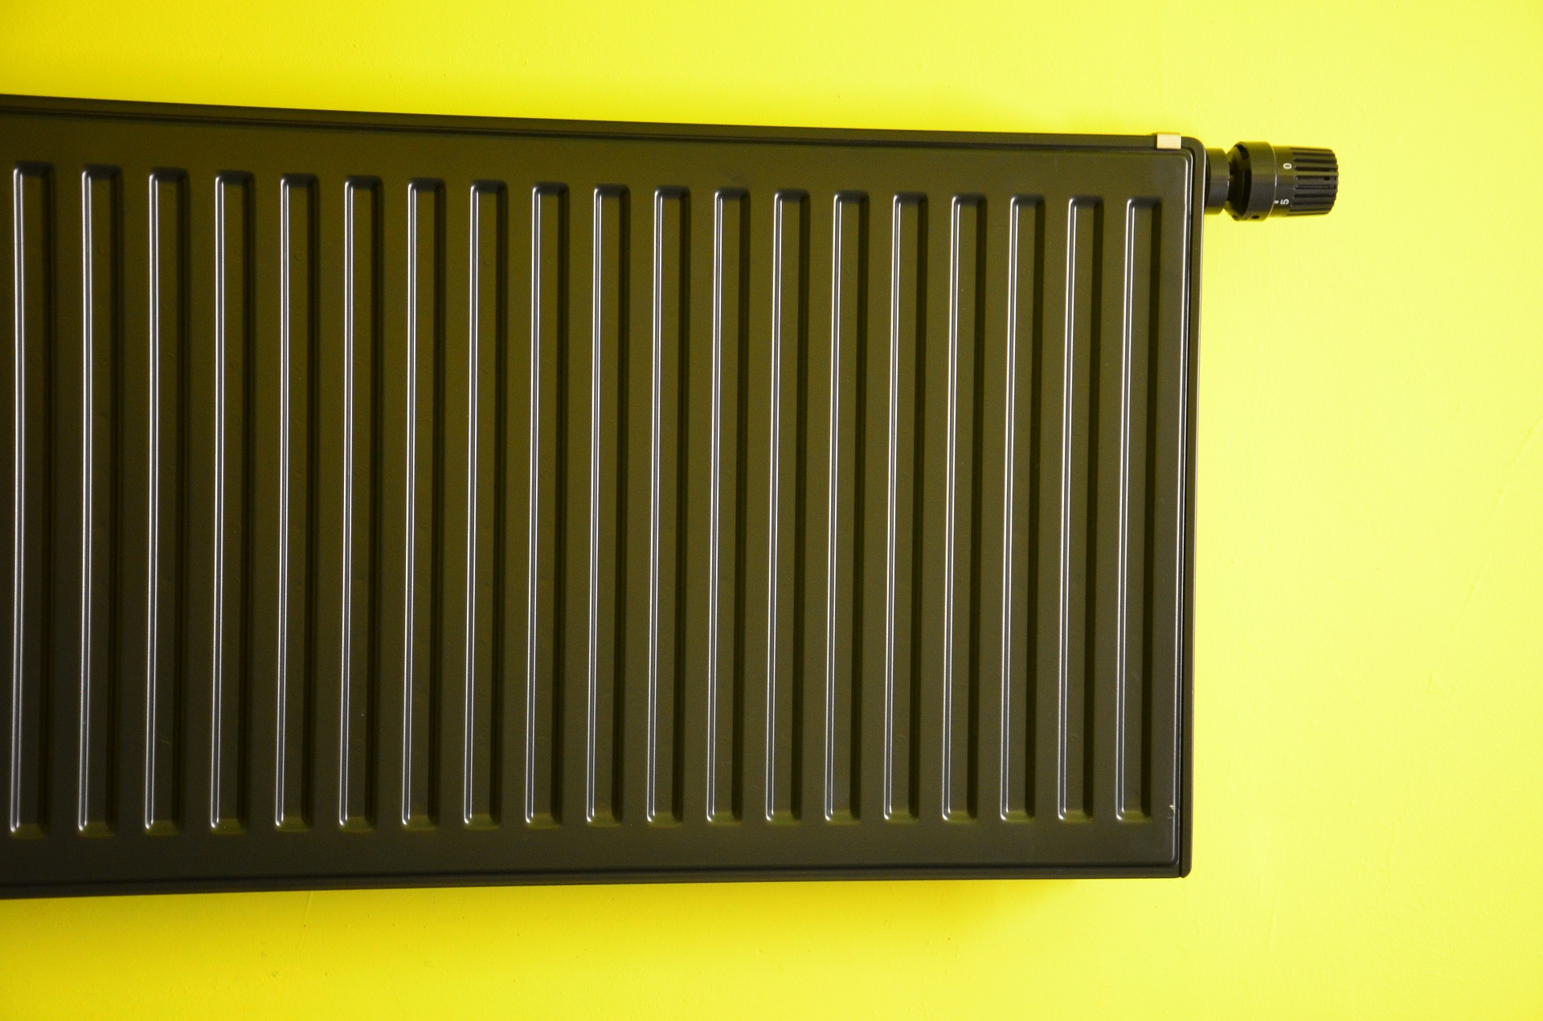
QUESTION 5
During the winter, do you find yourself turning off your heating completely?

Slide 13
Do not switch off the heating completely
For single-family houses: Never turn off the heating completely during the winter months.
For apartment blocks: When you are at work during the day or absent for one–two days in the winter months, do not leave the radiator-valves completely off. Leave them on at a lower degree so that the premises do not cool down completely.
When you close them completely after they have been switched on, radiators will consume additional time and energy to heat the already fully cooled room.
Notes:
Self-Assessment of the unit. Please copy this slide for all units you want to include in the module.

Slide 14
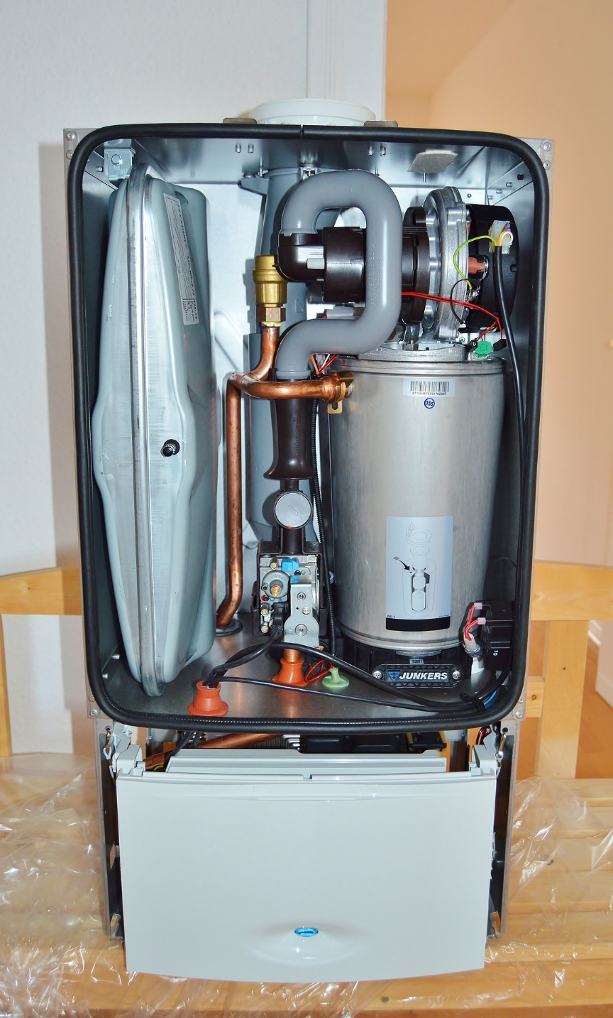
QUESTION 6
Do you use condensing gas boilers?

Slide 15
Heating with condensing gas boilers
Modern gas boilers, the so-called ‘condensing-gas-type boilers ’, operate in an exclusively efficient and energy saving way. Compared to new conventional gas appliances, modern condensing gas boilers can save about 15% energy consumption. These savings quickly exceeded 30% when compared to obsolete gas boilers with a pilot flame.
Notes:
Self-Assessment of the unit. Please copy this slide for all units you want to include in the module.

Slide 16
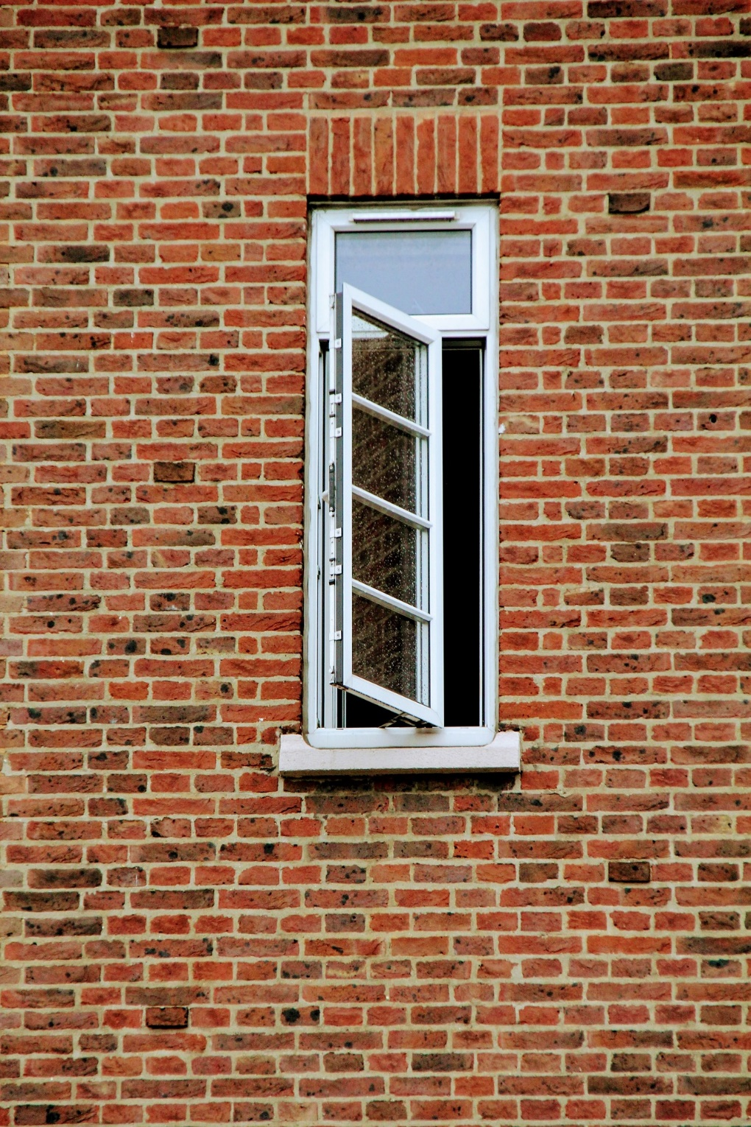
QUESTION 7
During the winter, do you often ventilate your home by leaving your windows slightly open for long periods of time?

Slide 17
Ventilate your premises regularly and for short periods of time
Ventilate your home by opening your windows fully for a few minutes every three hours during winter. For maximum effect, open the windows and the doors which are facing each other. This will improve the air quality in your home and reduce heating costs as opposed to ventilating with tilted windows. Do not leave windows partially opened constantly.
Notes:
Self-Assessment of the unit. Please copy this slide for all units you want to include in the module.

Slide 18
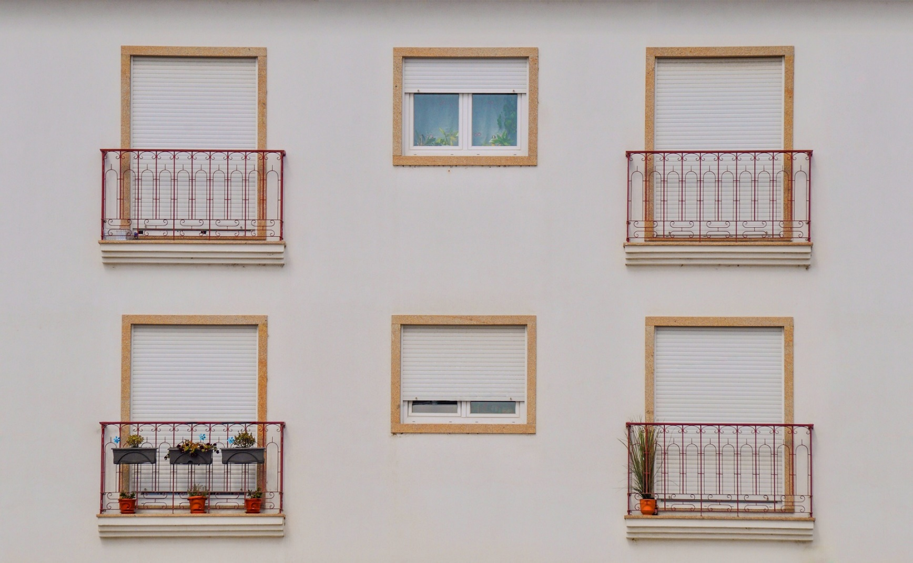
QUESTION 8
During the summer, do you often vent your home during the day?

Slide 19
Summer night’s dream
In the summer, keep your windows closed through the day when the temperatures outside are high. Instead, open the windows when it gets dark to take advantage of from the cooler and drier outside air. This usually prevents the warming of your home, creating a pleasant environment without the need for air conditioning.
Notes:
Self-Assessment of the unit. Please copy this slide for all units you want to include in the module.

Slide 20
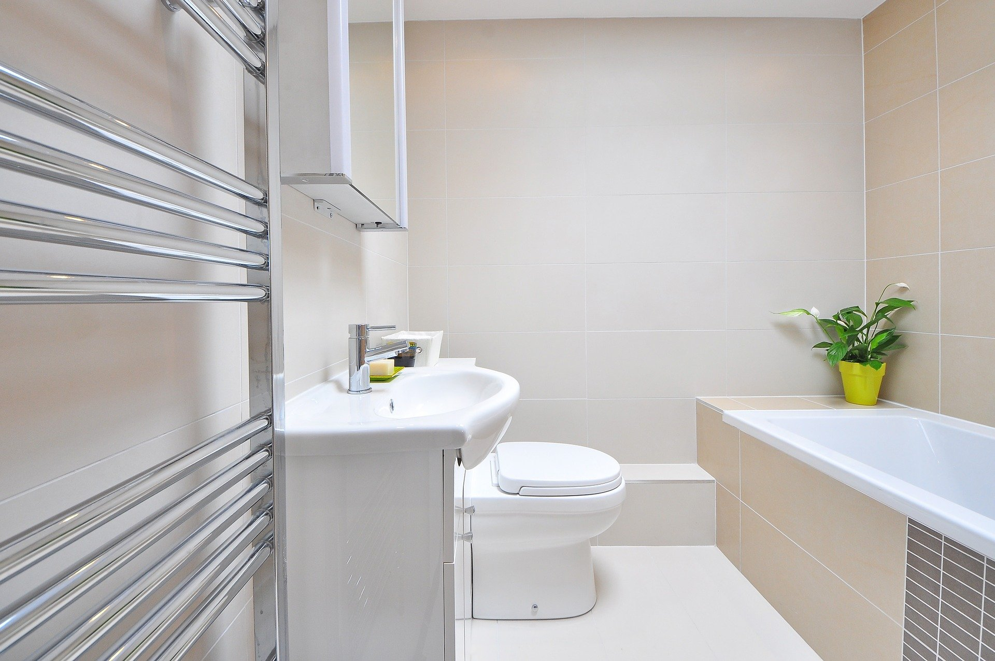
QUESTION 9
Do you sometimes heat your bathroom using your boiler?

Slide 21
Do not heat the bathroom through the boiler
Do not increase the temperature of your boiler unnecessarily.
Keep the minimum temperature sufficient for your needs, but no lower than 60° С. This will save energy. Temperatures below 60° C provide conditions for the development of pathogenic bacteria.
Notes:
Self-Assessment of the unit. Please copy this slide for all units you want to include in the module.

Slide 22
Additional tips for saving on heating
Choose an energy-efficient method for heating
Use window coverings wisely – against sun to keep your house cool / against cold to make sure the heat is kept in the room and is not wasted so quickly through (poorly insulated) windows
Apply reflective coating on window glass to reduce the amount of heat entering your home

