Slide 1
Topic 4 – Personal Choice: Consumption and efficiency
Unit 1 - Energy Efficiency
Activity 2 - Electricity / Water Efficiency

Slide 2
QUESTION 1
Do you think 1 kWh is sufficient enough to adequately complete any of the following tasks?
- Internet surfing;
- Watching TV;
- Dishwashing;
- Lighting the apartment;
- Using the air conditioner;

Slide 3
One kilowatt hour – what does this actually mean?
One kilowatt hour corresponds to the used energy from an electrical appliance with a capacity of one kilowatt (=1000W) for one hour. With it:
You can surf the Internet on your home computer an average of 6 hours;
You can watch 4 hours TV on a large plasma, flat screen;
You can wash the dishes with an effective dishwasher;
You can use a 100W lightbulb for 10 hours or an energy saving one of 20W for 50 hours;
You can turn on a household air conditioner for 1 hour;
You can run a sauna in your home for 8 minutes.
Notes:
Self-Assessment of the unit. Please copy this slide for all units you want to include in the module.

Slide 4
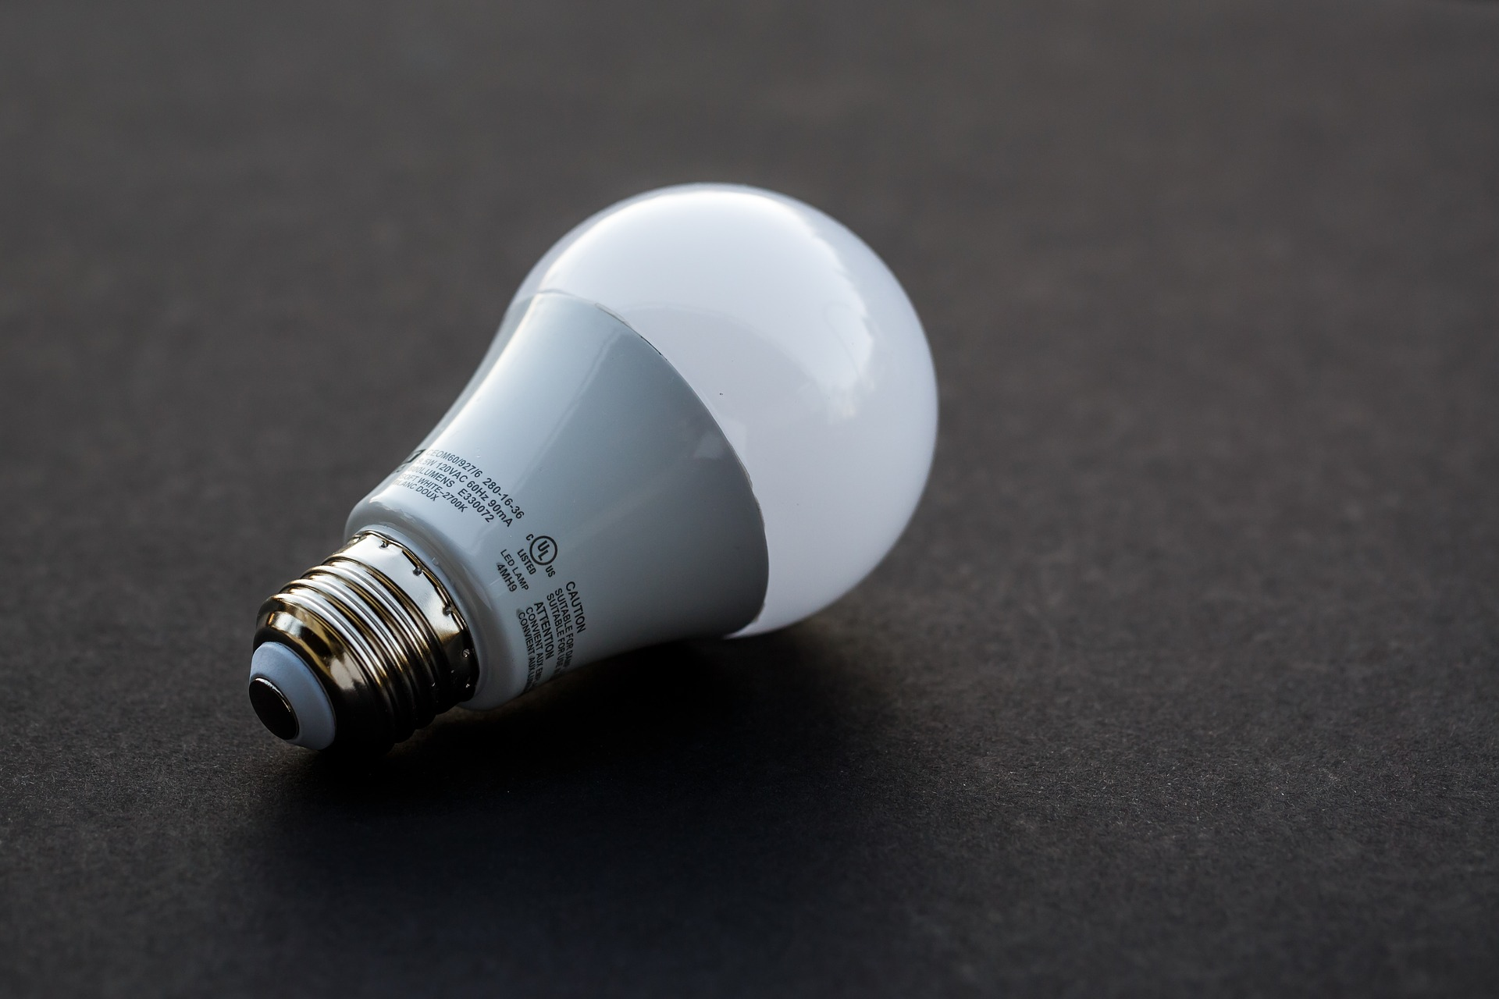
QUESTION 2
Do you use energy-saving light bulbs?

Slide 5
Use energy saving or LED bulbs
Energy saving light bulbs consume 4 times less energy then conventional light bulbs (incandescent). They last up to 5 times longer and emit significantly less heat than other bulbs.
LED bulbs are a rapidly evolving technology and become increasingly available on the market. They consume up to 10 times less than conventional light bulbs, and their life lasts 10-15 times longer.
Energy saving LED bulbs should be placed especially in rooms where they will be used for a longer time. This will not only increase your savings cost and bulb life, but also reduce heat dissipation.
Notes:
Self-Assessment of the unit. Please copy this slide for all units you want to include in the module.

Slide 6
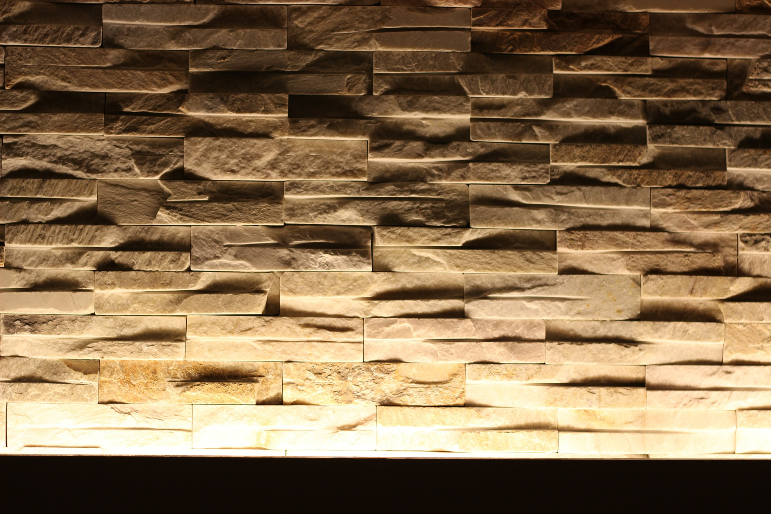
QUESTION 3
Do you use indirect lighting in any of the areas of your home?

Slide 7
Illuminate directly
Place light sources in larger rooms in such a way that every area in the room can be illuminated locally, avoiding indirect illumination. This saves electricity and reduces the amount of heat released.
Notes:
Self-Assessment of the unit. Please copy this slide for all units you want to include in the module.

Slide 8
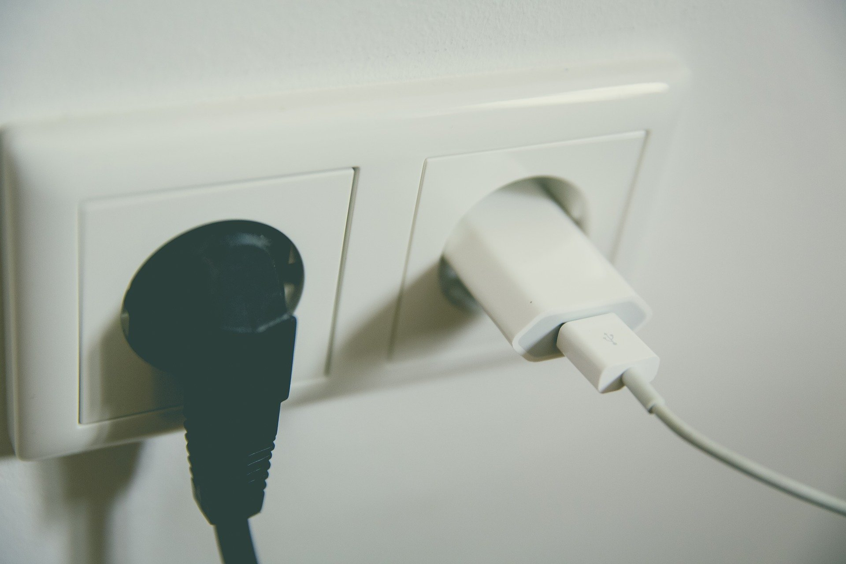
QUESTION 4
Do you make sure to stop the power supply to appliances when they are not going to be used?

Slide 9
Disconnect the power to unnecessary appliances
Use a power strip with a button to turn off power supply in order to make sure the electrical appliances do not consume electricity when turned off. Be careful when interrupting appliances where unsaved data may be lost, as can be the case with video recorders.
Notes:
Self-Assessment of the unit. Please copy this slide for all units you want to include in the module.

Slide 10
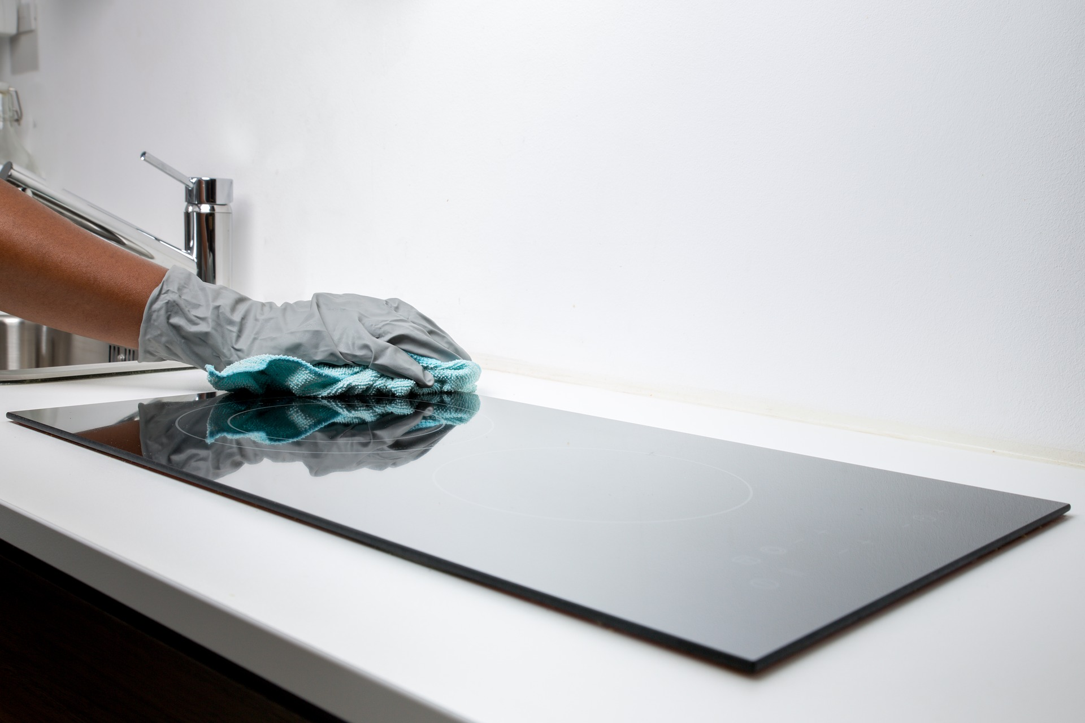
QUESTION 5
Do you clean your electrical appliances from scale/incrustation?

Slide 11
Prevent and reduce scale formation
Appliances covered with scale consume more energy and are less effective. In addition, the scale creates conditions for the development of bacteria and is a common cause of Legionnaires' disease. Clean appliances regularly to increase their efficiency, and for the benefit of your health.
Notes:
Self-Assessment of the unit. Please copy this slide for all units you want to include in the module.

Slide 12
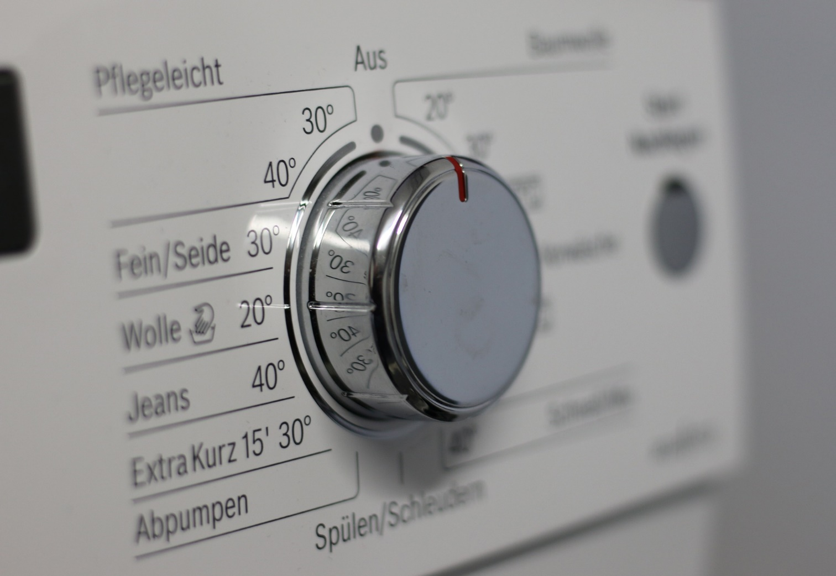
QUESTION 6
Do you often set the temperature on your washing machine above 60 °С when washing your clothes?

Slide 13
Do not wash with too hot water
It is seldom necessary to wash fabrics at 95° C. In most cases, due to the use of modern detergents to wash cotton or other fabrics, 60° C and often 40° C are a sufficient washing temperature. This way you can save about a third of energy consumption, and reduce the wear of tissues.
Notes:
Self-Assessment of the unit. Please copy this slide for all units you want to include in the module.

Slide 14
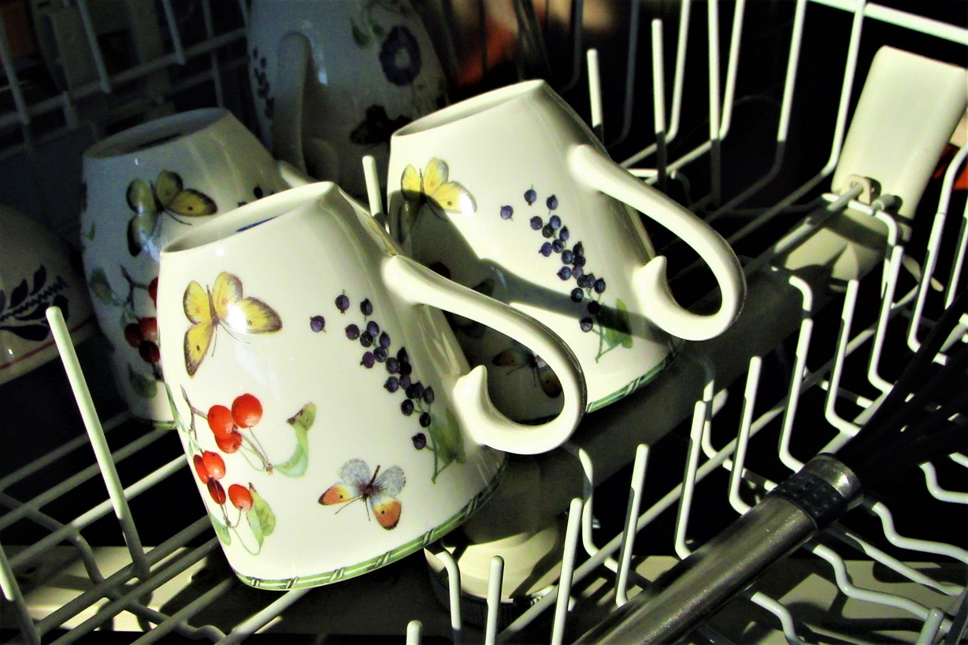
QUESTION 7
Do you use a dishwashing machine?
If yes, do you fill it up to its full capacity before you run it?

Slide 15
Use dishwashers fully loaded
Dishwashers help us save energy and water. Modern dishwashers from Class A require about 1 kWh of electricity and 10 liters water for washing one charge. To wash the same amount of dishes so efficiently by hand, you will consume around one third more energy and 5-10 times more water, for which you will also need extra time.
Make sure you take full advantage of your dishwasher by turning it on only when fully loaded.
Notes:
Self-Assessment of the unit. Please copy this slide for all units you want to include in the module.

Slide 16
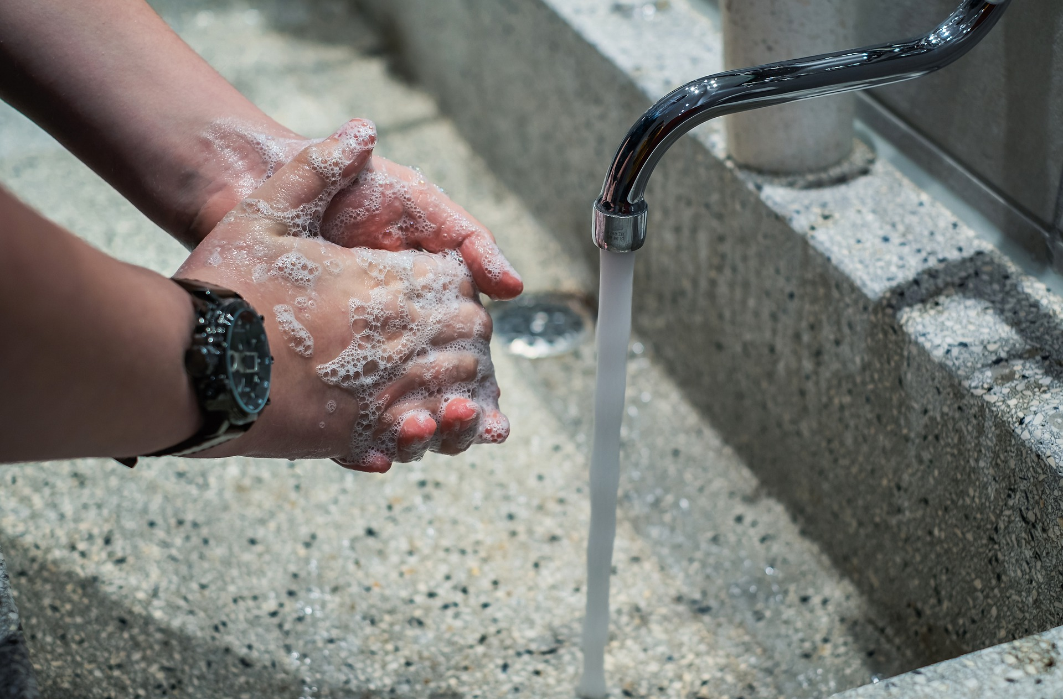
QUESTION 8
Do you find yourself leaving the tap on while brushing your teeth or shaving?

Slide 17
Stop the flow of water
When brushing or shaving, avoid letting the water run. This, at first glance insignificant-flax daily ritual, may end with the expenditure of surprising amount of energy and water.
Notes:
Self-Assessment of the unit. Please copy this slide for all units you want to include in the module.

Slide 18
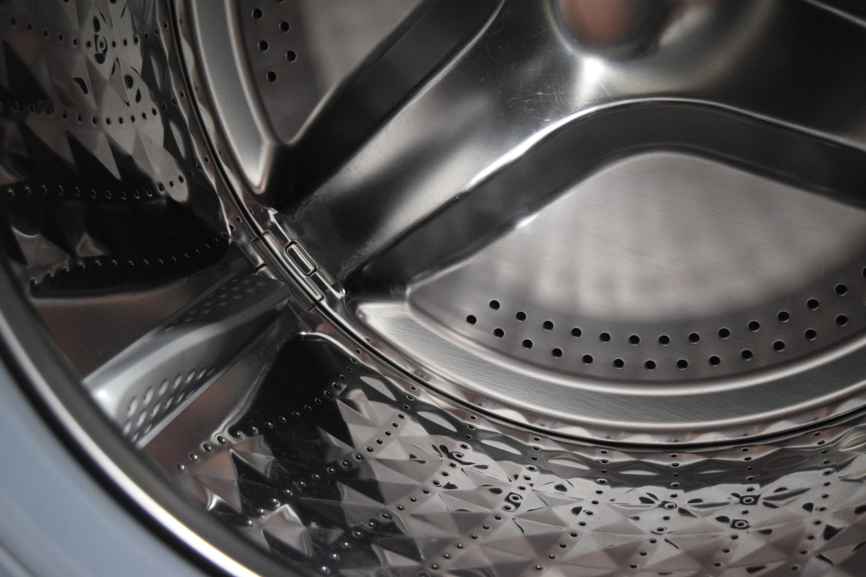
QUESTION 9
Do you often run your washing machine on a pre-wash mode?

Slide 19
Do not run the washing machine with prewash mode
It is necessary to start the washing machine with pre-washing only for heavily soiled fabrics. Avoid using prewash for little soiled laundry. This way you will save both energy and water.
Notes:
Self-Assessment of the unit. Please copy this slide for all units you want to include in the module.

Slide 20
Additional tips for saving power
Install dimmer switches to control your lights
Install motion sensors in your exterior, which turn your lights on only when something or someone is moving
Hang dry your laundry instead of using the dryer
Keep fridge and freezer at ideal temperature
Defrost your freezer regularly
Use the “economy mode” setting on appliances
When purchasing a new electronic device, get a model that is “energy star” certified
Look up energy saving hacks and apply them at home

Slide 21
Additional tips for saving water
Monitor your water bill for unusually high use.
Take shorter showers
Fix any leaky faucet, Check your toilet for leaks
Install water-saving shower head or flow restrictors
Switch off the hose while washing your car or use a bucket and sponge
If you install a new toilet, make sure it has a dual-flush system
Collect rainwater or water from the sink for watering plants.
Water your outdoor plants during the cool parts of the days
Put a layer of mulch around your plants/trees in the garden to slow down the evaporation of moisture
Use filtered tap water for drinking rather than energy and water-intensive bottled water

